Slide 1
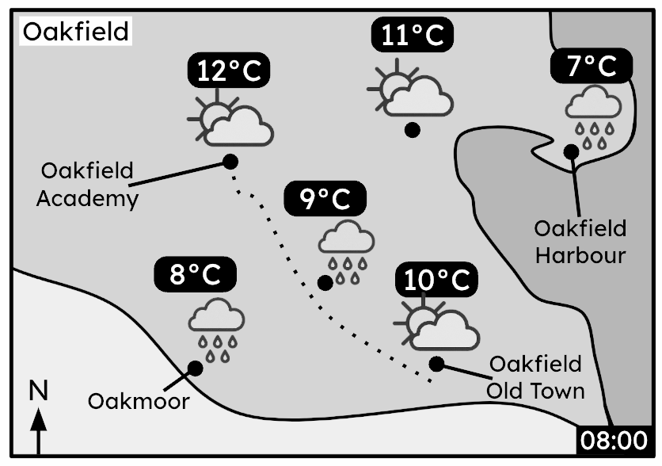







Understanding weather data
Task A: Understanding a basic weather forecast
1) At 8 am, Sofia cycles to Oakfield Academy from her house near the Old Town. The dotted line shows Sofia’s route.
Sofia has the following items:
sunglasses (for constant sunny weather)
raincoat (for any amount of rain)
scarf (if the temperature drops below 10°C)
Which should she bring for her journey to Oakfield Academy? Justify your answer for each one.
Sofia should bring her raincoat, as she passes in between two locations that show rainfall.
Sofia should also bring her scarf, as in the locations with rainfall, the temperature drops below 10°C (at 8°C and 9°C).
Sofia does not need to bring sunglasses, as there are only sunny intervals at Oakfield Academy, not constant sun.
2) This weather report shows weather data for 1st June 2024.
00:00 | 02:00 | 04:00 | 06:00 | 08:00 | 10:00 | 12:00 | 14:00
9°C | 10°C | 8°C | 10°C | 13°C | 12°C | 11°C | 12°C
weather at “Oakfield Harbour”
Between 4 am and 6 am.
a) Between which two times is sunrise?
b) Describe the trend in the weather conditions between 8 am and 12 pm.
c) What is the mean temperature during the night-time hours?
d) Which of these weather conditions is likely at 1 pm? Justify your choices.
The rainfall increases from rain showers to heavy rain. The temperature also drops 2°C, from 13°C to 11°C.
9°C
sunny
sunny intervals
rain showers
heavy rain
lightning

Slide 2

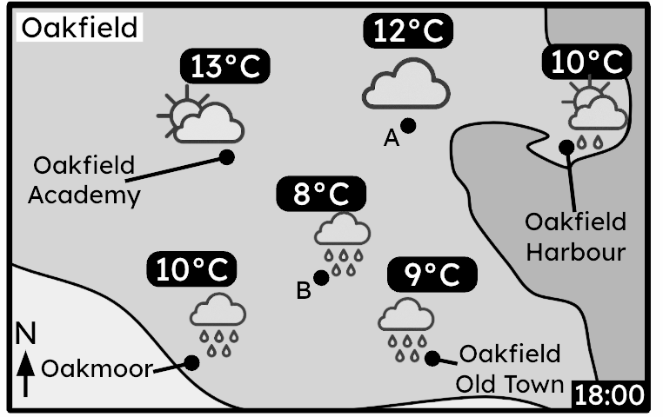
Understanding weather data
3) The weather report is for a location in Oakfield.
00:00 | 03:00 | 06:00 | 09:00 | 12:00 | 15:00 | 18:00 | 21:00
6°C | 5°C | 9°C | 12°C | 13°C | 12°C | 10°C | 10°C
a) Which location in Oakfield does this weather report most likely represent?
b) What is the range of temperatures at this location?
c) The range of temperatures at location A is the same as the range in the report location. What are the maximum and minimum temperatures at location A?
Oakmoor. This is because both the report and map show heavy rain and a temperature of 10°C at 6 pm.
The range of temperatures in Oakmoor (from the weather report) is 13°C – 5°C = 8°C.
12°C + 8°C = 20°C
or
12°C – 8°C = 4°C

Slide 3
Understanding weather data
Task B: Analysing extra forecast information
1) This weather report shows the weather forecast for Oakfield Harbour.
 | 00:00 | 03:00 | 06:00 | 09:00 | 12:00 | 15:00 | 18:00 | 21:00
air temperature | 13°C | 15°C | 15°C | 22°C | 24°C | 18°C | 14°C | 12°C
wind speed (km/h) | 2 | 5 | 7 | 3 | 8 | 14 | 11 | 2
wind direction | ↗ | ↑ | ↑ | ← | ← | ← | ← | ←
“feels like” | 13°C | 14°C | 14°C | 21°C | 22°C | 14°C | 10°C | 9°C
a) Which wind directions results in the most and least difference between air temperature
and the “feels like” temperature?
b) A cold front will blow over Oakfield Harbour. Using the weather report, write down the
most likely time this will happen, and justify your answer.
Southerly winds result in the least difference (maximum 1°C difference).
Easterly winds result in the most difference (maximum 4° difference).
The cold front likely blew over Oakfield Harbour between 12 pm and 3 pm. This is because the weather conditions went from sunny intervals to heavy rain, and the temperature started to drop significantly, starting from this timeframe.
2) Humidity measures the amount of moisture in the air. It also influences “feels like” temperature.
Weather report on 1st July at Oakfield Old Town.
Weather report on 10th July at Oakfield Old Town.
 | 08:00 | 11:00 | 14:00 | 17:00
air temperature | 6°C | 10°C | 17°C | 18°C
humidity | 30% | 45% | 70% | 65%
“feels like” | 5°C | 12°C | 20°C | 20°C
 | 08:00 | 11:00 | 14:00 | 17:00
air temperature | 6°C | 10°C | 17°C | 18°C
humidity | 20% | 20% | 15% | 15%
“feels like” | 5°C | 9°C | 16°C | 17°C
a) On which day, and at what time, was there the greatest difference between the air temperature and the “feels like” temperature?
The greatest difference was on the 1st July at 2 pm. The “feels like” temperature was 3°C higher than the air temperature.
b) Complete this sentence:
“Higher humidity likely leads to an increase in “feels like” temperature compared to air temperature.”
c) What weather conditions might result in higher humidity?
The evaporation of rainfall due to high temperatures might result in higher humidity.

Slide 4
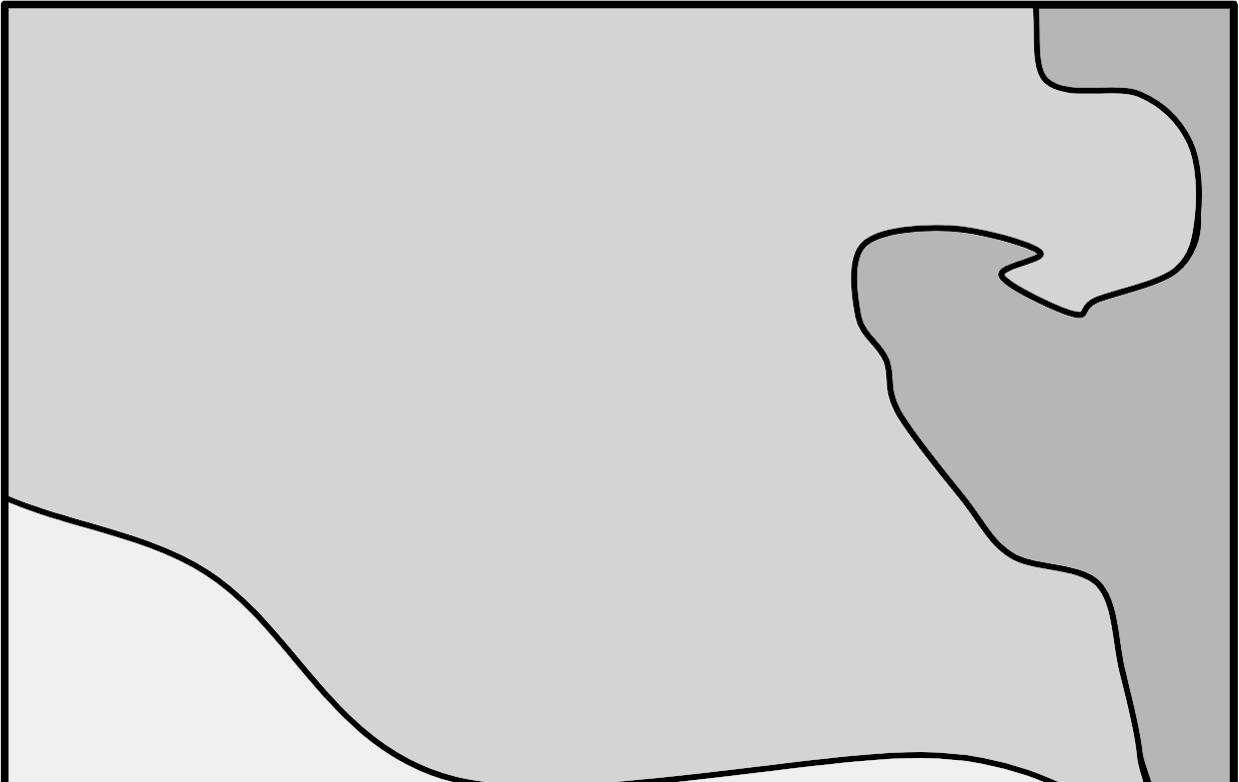
Understanding weather data
3) Using the information given on the weather map and weather report, make a sensible
prediction on the missing details of the weather conditions at 4 pm at Oakmoor.
Write a sentence justifying your prediction.
 | 12:00 | 16:00
air temperature | 11°C | 6°C
wind speed (km/h) | 8 | 12
wind direction | ↙ | ↙
% chance of rain | 20% | 80%
“feels like” | 13°C | 14°C
An example of a set of suitable predictions.
Oakfield
Oakfield
Academy
A
Oakfield
Harbour
B
N
Oakfield
Old Town
Oakmoor
12:00
weather at “Oakmoor”
The wind direction is likely to blow the cold front across Oakmoor. The cold front will reduce the air temperature and increase the chance of rainfall. Due to the stronger winds and greater chance of rain, the “feels like” temperature may also drop further.
Mathematics in Education and Industry
v2.4

